Slide 1
HEART DISEASE PREDICTION
Malla Abhishek(RA1911003010973)
C.Saraswathi(RA1911003010998)
Dhev Darshan R(RA1911003010997)
Sai Manoj(RA1911003010977)

Slide 2
INTRODUCTION
According to the World Health Organization, every year 12 million deaths occur worldwide due to Heart Disease.
The load of cardiovascular disease is rapidly increasing all over the world from the past few years.
Many researches have been conducted in attempt to pinpoint the most influential factors of heart disease as well as accurately predict the overall risk
The early diagnosis of heart disease plays a vital role in making decisions on lifestyle changes in high-risk patients and in turn reduce the complications. This project aims to predict future Heart Disease by analyzing data of patients which classifies whether they have heart disease or not using machine-learning algorithms.

Slide 3
PROBLEM DEFINITION
The major challenge in heart disease is its detection. There are instruments available which can predict heart disease but either they are expensive or are not efficient to calculate chance of heart disease in human.
Early detection of cardiac diseases can decrease the mortality rate and overall complications.However,it is not possible to monitor patients everyday in all cases accurately and consultation of a patient for 24 hours by a doctor is not available since it requires more sapience,time and expertise. Since we have a good amount of data in today’s world, we can use various machine learning algorithms to analyze the data for hidden patterns. The hidden patterns can be used for health diagnosis in medicinal data.

Slide 4
DATA SETS
The data set used is Heart Disease UCI which is taken from kaggle.
The dataset contains 14 columns such as :
Age
Sex
Chest Pain Type
Resting Blood Pressure
Serum Cholestorol in mg/dl
Fasting Blood Sugar
resting electrocardiographic results (values 0,1,2)
maximum heart rate achieved
exercise induced angina
oldpeak = ST depression induced by exercise relative to rest
the slope of the peak exercise ST segment
number of major vessels (0-3) colored by flourosopy
thal: 0 = normal; 1 = fixed defect; 2 = reversable defect

Slide 5
Essential Libraries:
numpy
pandas
matplotlib
Seaborn
warnings

Slide 6
Steps in Prediction:
Importing essential libraries
Importing and understanding our dataset
Exploratory Data Analysis (EDA)
Train Test split
Model Training
Model Evaluation
Building a Predictive System

Slide 7
ALGORITHMS USED:
Logistic Regression (Scikit-learn)
Naive Bayes (Scikit-learn)
Support Vector Machine (Linear) (Scikit-learn)
K-Nearest Neighbours (Scikit-learn)
Decision Tree (Scikit-learn)
Random Forest (Scikit-learn)
XGBoost (Scikit-learn)
Artificial Neural Network with 1 Hidden layer (Keras)

Slide 8
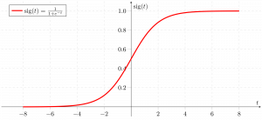
Logistic Regression
Logistic regression is basically a supervised classification algorithm. In a classification problem, the target variable(or output), y, can take only discrete values for a given set of features(or inputs), X.
Logistic regression becomes a classification technique only when a decision threshold is brought into the picture. The setting of the threshold value is a very important aspect of Logistic regression and is dependent on the classification problem itself.

Slide 9
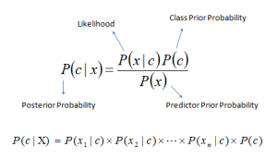
Naive Bayes
Naive Bayes model is easy to build and particularly useful for very large data sets. Along with simplicity, Naive Bayes is known to outperform even highly sophisticated classification methods.
The most important assumption that Naive Bayes makes is that all the features are independent of each other. You might also need to convert the continuous variables into discrete variables.
It is fast, intuitive, and is used for text classification tasks. Since it can be used for multiclass classification as well, it is considered a very versatile and flexible classifier.

Slide 10

Support Vector Machine
The goal of Support Vector Machine(svm) the algorithm is to create the best line or decision boundary that can segregate n-dimensional space into classes so that we can easily put the new data point in the correct category in the future. This best decision boundary is called a hyperplane.
SVM chooses the extreme points/vectors that help in creating the hyperplane. These extreme cases are called as support vectors, and hence algorithm is termed as Support Vector Machine. Consider the below diagram in which there are two different categories that are classified using a decision boundary or hyperplane

Slide 11
k-nearest neighbors (KNN)
The k-nearest neighbors (KNN) algorithm is a simple, supervised machine learning algorithm that can be used to solve both classification and regression problems. It’s easy to implement and understand, but has a major drawback of becoming significantly slows as the size of that data in use grows.
KNN works by finding the distances between a query and all the examples in the data, selecting the specified number examples (K) closest to the query, then votes for the most frequent label (in the case of classification) or averages the labels (in the case of regression).

Slide 12
XG BOOST
XGBoost, which stands for Extreme Gradient Boosting, is a scalable, distributed gradient-boosted decision tree (GBDT) machine learning library. It provides parallel tree boosting and is the leading machine learning library for regression, classification, and ranking problems
XGBoost dominates structured or tabular datasets on classification and regression predictive modeling problems. The evidence is that it is the go-to algorithm for competition winners on the Kaggle competitive data science platform.
It is second most priority algortihm used in heart disease prediction

Slide 13
Random Forest:
Random forest is a Supervised Machine Learning Algorithm that is used widely in Classification and Regression problems. It builds decision trees on different samples and takes their majority vote for classification and average in case of regression.
One of the most important features of the Random Forest Algorithm is that it can handle the data set containing continuous variables as in the case of regression and categorical variables as in the case of classification. It performs better results for classification problems.

Slide 14
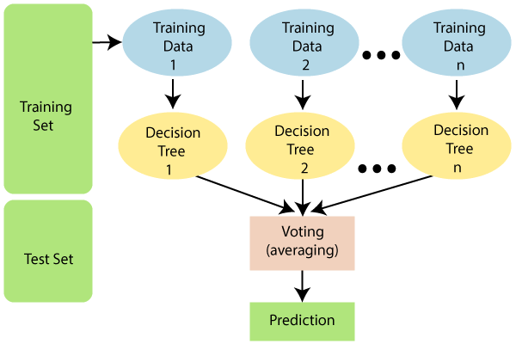

Slide 15
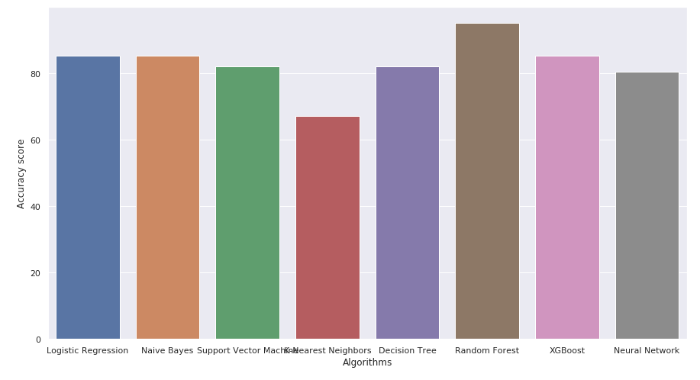
Result:
Random Forest Algorithm gives the Highest Accuracy of 95%

